Slide 1
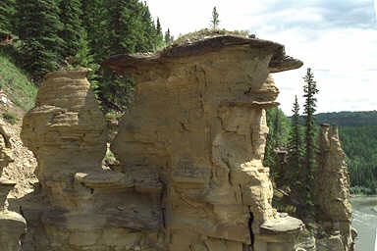
Landslides
http://

Slide 2
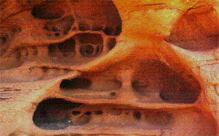
Mountains, and valleys form as tectonic plates crash into one another (convergent). These mountains do not last forever. As they age, they are torn down by the very slow, but persistent forces of weathering, mass wasting, and erosion.
We will examine the first two processes, which are weathering, and mass wasting. These two forces are usually overlooked when people consider the development of landscape, yet they are incredibly important.
Weathering takes place as rocks are broken down into progressively smaller pieces by the effects of weather. These pieces do not move to a new location, they simply break down, but remain next to one another.

Slide 3
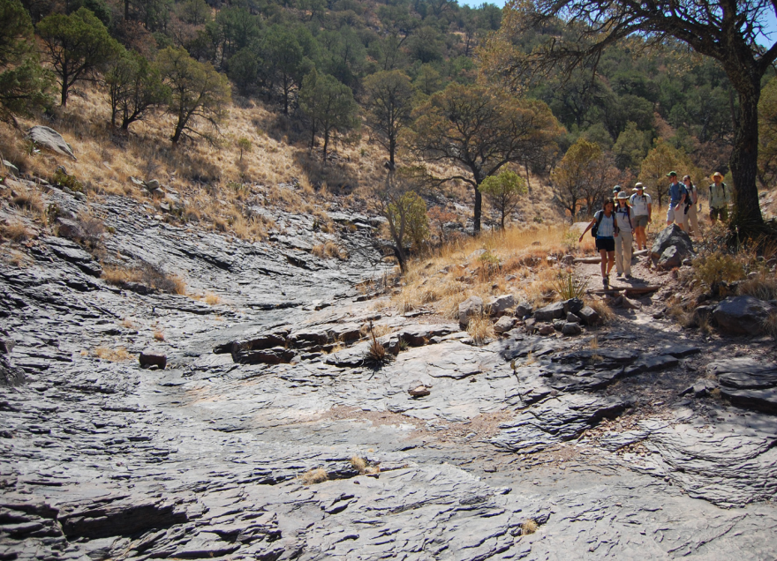
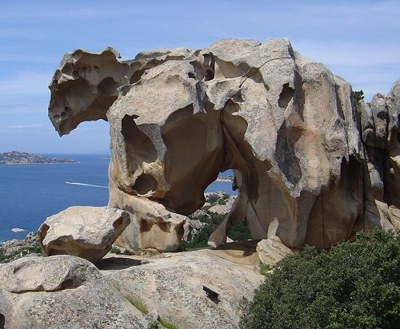
A large chunk of bedrock many hundreds of feet long is broken down into smaller and smaller pieces, until finally there are many tens of thousands of small rocks. Often rocks are broken down so much that they become dirt.
Weathering is caused by water, as it freezes and thaws, as well as by chemical reactions that loosen the bonds holding rocks together.
Weathering is most common at the surface where exposed bedrock meets the atmosphere. However, weathering can extend many thousands of feet downward into the Earth’s crust, following cracks, fissures, and microscopic holes that allow water to penetrate.

Slide 4
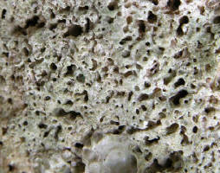
Microscopic Spaces
Microscopic spaces between the grains of a rock are numerous. These spaces act like microscopic caves, allowing water to flow freely through them.
As water travels through these spaces, it causing weathering, as chemicals are carried with it that can loosen the bonds between grains, and help to break the rock into smaller pieces. In some cases, the rocks become so weak, that they can be crumbled with the force of a bare hand.

Slide 5
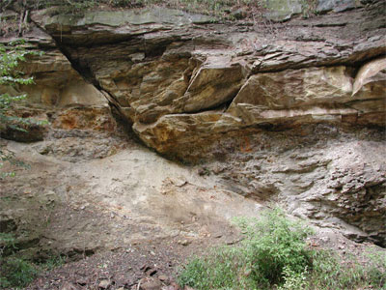
Faults And Erosion
A fault is a crack in the bedrock where neither side is held together. As a result, both sides are free to move independently of one another. Faults are typically much larger than joints, and can span in some cases several hundred miles.
Faults are responsible for significant weathering. This is because of their size. They allow significant amounts of water to enter the bedrock.

Slide 6
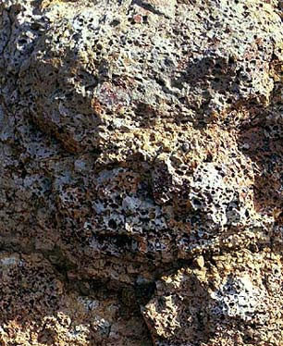
Lava Vesicles and Erosion
As lava cools, bubbles of hot gas often form. These bubbles become suspended in the thickening lava and are unable to escape. As a result, the cooling lava is very porous, leaving very large spaces though which water can travel.

Slide 7
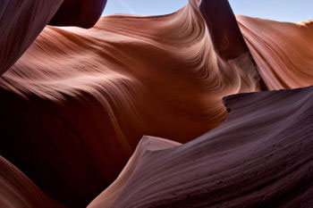
The Forces of Weathering
The atmosphere is comprised of many different types of gases. These gases are able to penetrate into the openings of rocks. Plant roots, microscopic animals and plants, and digging animals also help to break down rocks. To better understand the different forces that cause weathering, geologists separate them into three categories. These categories are mechanical, chemical, and biotic.

Slide 8
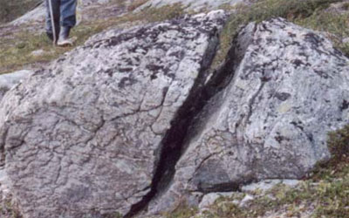
Mechanical Weathering
Mechanical weathering takes place when rocks are broken down without any change in the chemical nature of the rocks. The rocks are essentially torn apart by physical force, rather than by chemical breakdown.
The forces that break rocks down can be numerous, and include such things as pent up energy as the Earth’s crust slowly moves. When great amounts of pressure build up, the resulting mechanical effect can be that very large joints, or faults are created.

Slide 9
Mechanical Weathering continued …
The most common type of mechanical weathering is the constant freezing, and thawing of water. In liquid form, water is able to penetrate the many holes, joints, and fissures within a rock. As the temperature drops below 32 ° F, this water freezes. As water freezes, it expands, becoming about 10% larger than it was in liquid form. The result is that the holes and cracks in rocks are pushed outward. Even the strongest rocks are no match for this force.
As the water thaws, it is then able to penetrate further into the widened space, where it later freezes yet again. The expansion of holes and cracks is very slow. However, water does not mind. It is very patient. Month after month, year after year, water freezes and thaws over and over, creating larger and larger holes and cracks in the rocks.
Another important type of mechanical weathering is salt wedging. As water enters the holes and cracks in the surface of rocks, it often carries salt with it. As the water later evaporates, the salt is left behind. Over time, these salt deposits build up, creating pressure that can cause rocks to split and weaken.
Temperature changes also effect mechanical weathering. As temperatures heat up, the rocks themselves expand somewhat. As the temperatures cool down, rocks contract slightly. The effect can be the weakening of the rock itself.

Slide 10
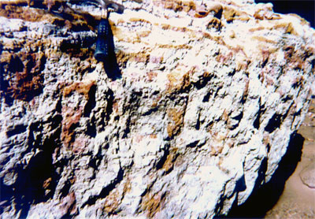
Chemical Weathering
Chemical weathering takes place in almost all types of rocks. Smaller rocks are more susceptible, however, because they have a greater amount of surface area.
Chemical reactions break down the bonds holding the rocks together, causing them to fall apart, forming smaller and smaller pieces. Chemical weathering is much more common in locations where there is a lot of water. This is because water is important to many of the chemical reactions that can take place. Warmer temperatures are also more friendly to chemical weathering. The most common types of chemical weathering are oxidation, hydrolysis and carbonation.

Slide 11
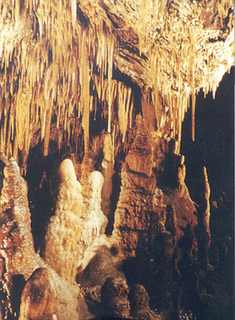
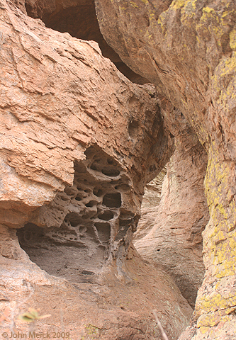
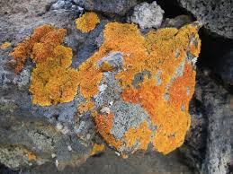
Oxidation takes place when oxygen combines with other elements in rocks to form new types of rock. These new substances are usually much softer, and thus easier for other forces to break apart.
Hydrolysis occurs when water combines with the substances in rocks to form new types of substances, which are softer than the original rock types. This allows other forces, such as mechanical weathering, to more easily break them apart.
Carbonation takes place when carbon dioxide reacts with certain types of rocks forming a solution that can easily be carried away by water.

Slide 12
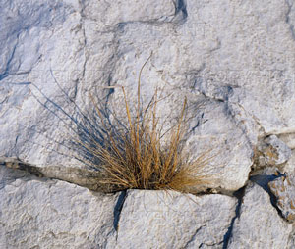
Biotic Weathering
The word ‘bio’ means life. Thus biotic weathering is any type of weathering that is caused by living organisms. Most often the culprit of biotic weathering are plant roots. These roots can extend downward, deep into rock cracks in search of water, and nutrients. In the process they act as a wedge, widening and extending the cracks.
Other causes of biotic weathering are digging animals, microscopic plants and animals, algae and fungi.

Slide 13
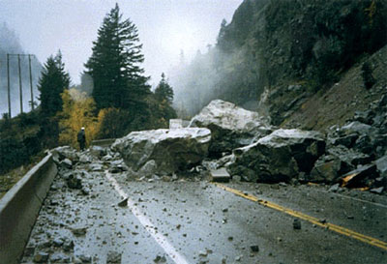
The power of gravity on Earth is inescapable. Hold your hand high above your head, and then relax your muscles. What happens? Now, hold a book in the air and release it. Again, what happens? The force of gravity tugs at both your arm and the book, pulling them down towards the center of the Earth.
The same force that pulls your arm down is also ever at work pulling rocks, boulders, dirt and dust downward. Whenever the opportunity presents itself, gravity pulls a rock lower and lower towards the lowest surface possible.
Mass Wasting

Slide 14
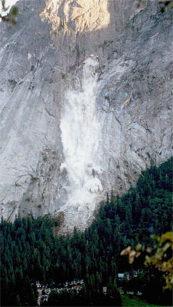
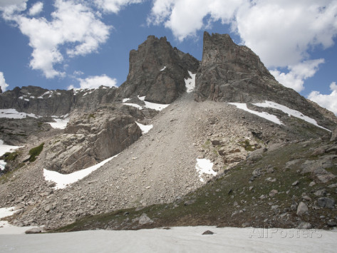
The most common type of mass wasting is falling. Rocks, builders, pebbles, and dirt loosened by freezing, weathering, and other forces, simply fall downward, until they hit something that stops their descent.
Rock Falls
Often a pile of rocks forms at the bottom of a cliff or mountain. We call a pile of rocks, boulders, and dirt a talus. Very often, these taluses form a cone shape, as they ascend up the side of the mountain.

Slide 15
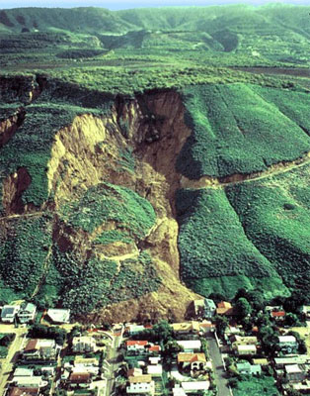
Landslides
Landslides take place when dirt, pebbles, rocks and boulders slide down a slope together. Sometimes these landslides are small, and hardly noticeable. Other times however, they can be substantial, involving the entire side of a mountain.

Slide 16
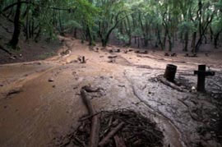
Flows
Flows take place much more slowly than do slides, and usually involve great amounts of water. After a heavy rainstorm the ground can become too wet to absorb any additional water. The result is that the water is forced to run off on the surface, gathering dust, dirt, rocks, and in some cases even boulders as it builds up. The leading edge of a flow gathers the most debris, causing it to be thicker and slower moving. This acts as a slow moving dam. Eventually, such as in a wide area on a slope, the more liquid mud from behind breaks through the dam and rushes outward creating a muddy plain.

Slide 17
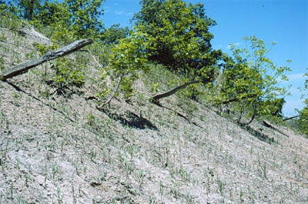
Creeps
The slowest type of mass wasting is referred to by geologists as a creep. These types of movements are so slow that they require special equipment just to measure them.

Slide 18
https://www.youtube.com/watch?v=chWk1v50KfQ

